Slide 1

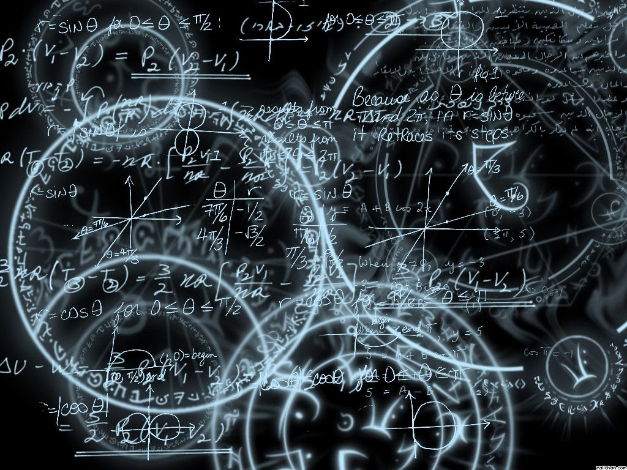
Azərbaycan Dövlət Neft və Sənaye Universiteti
Calculus
Single Variable

Slide 2
Product and Quotient Rules and Higher-Order Derivatives

Slide 3
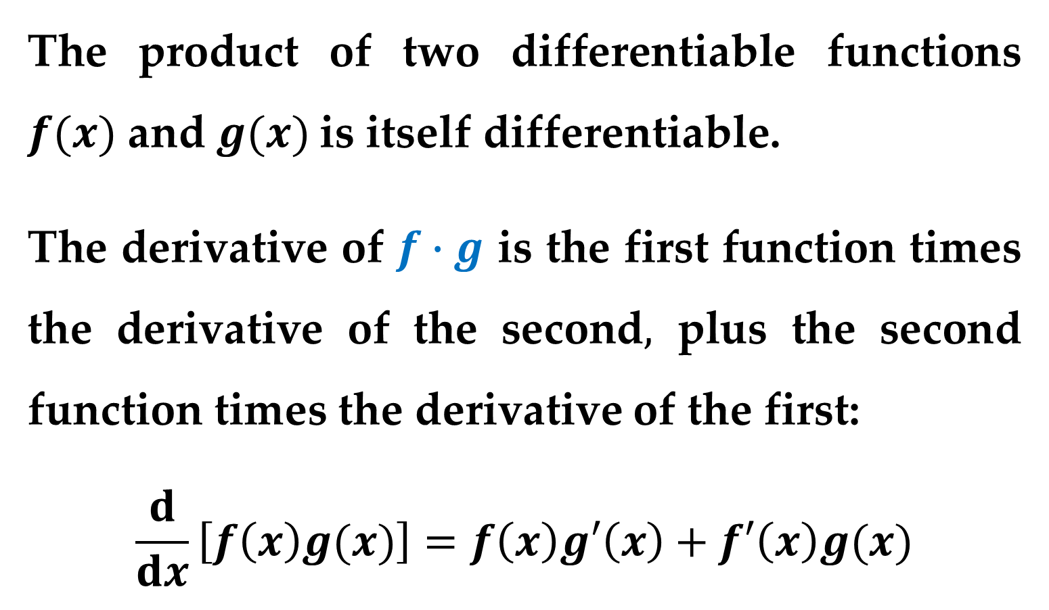
The Product Rule
The product of two differentiable functions $f(x)$ and $g(x)$is itself differentiable.
The derivative of $f∙g$ is the first function times the derivative of the second$,$ plus the second function times the derivative of the first:
$$\frac{d}{dx}\left[f\left(x\right)g(x)\right]=f\left(x\right)g′\left(x\right)+f′\left(x\right)g(x)$$

Slide 4
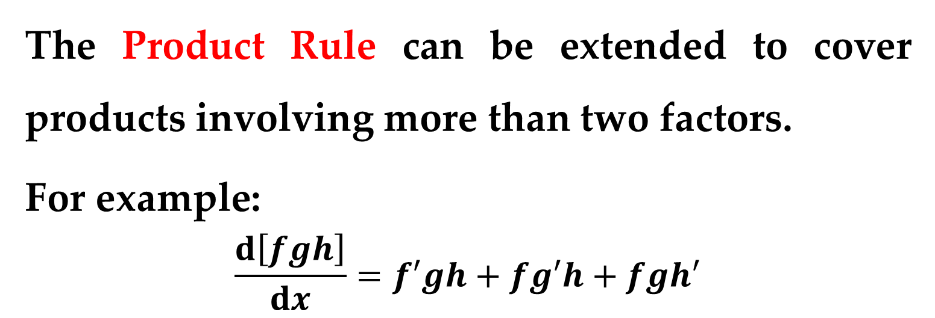
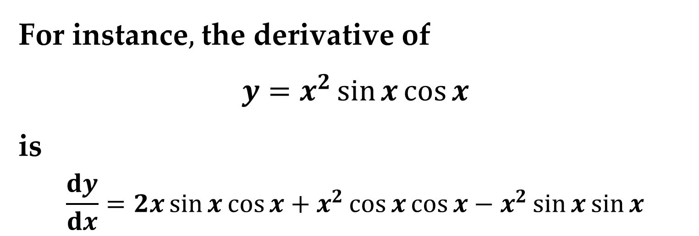
The Product Rule can be extended to cover products involving more than two factors.
For example:
$$\frac{d\left[fgh\right]}{dx}=f′gh+fg′h+fgh′$$
For instance$,$ the derivative of
$$y=x^{2}\sin{x}\cos{x}$$
is
$$\frac{dy}{dx}=2x\sin{x}\cos{x}+x^{2}\cos{x}\cos{x}−x^{2}\sin{x}\sin{x}$$

Slide 5
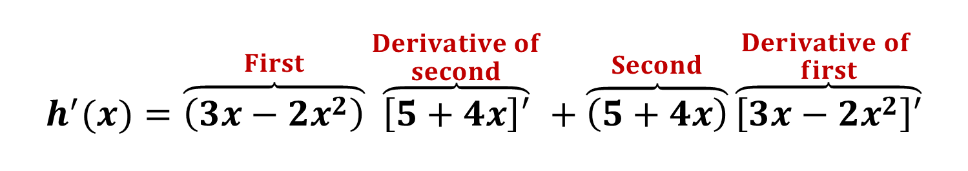

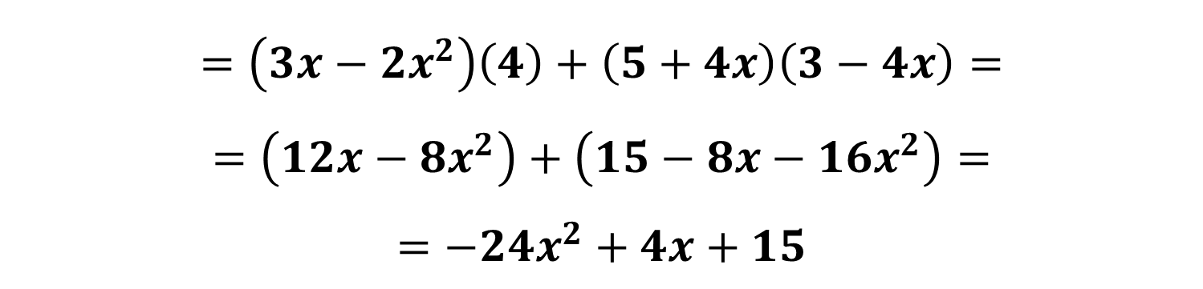
Example 1. Using the Product Rule
Find the derivative of
$$h\left(x\right)=(3x−2x^{2})(4x+5)$$
Solution
$$h^{′}(x)=\overset{First}{\overbrace{\left(3x−2x^{2}\right)}}\overset{\begin{aligned}Derivative of \\ second\end{aligned}}{\overbrace{\left[5+4x\right]′}}+\overset{Second}{\overbrace{\left(5+4x\right)}}\overset{\begin{aligned}Derivative of \\ first\end{aligned}}{\overbrace{\left[3x−2x^{2}\right]′}}$$
$$=\left(3x−2x^{2}\right)\left(4\right)+\left(5+4x\right)\left(3−4x\right)=$$
$$=\left(12x−8x^{2}\right)+\left(15−8x−16x^{2}\right)=$$
$$=−24x^{2}+4x+15$$

Slide 6
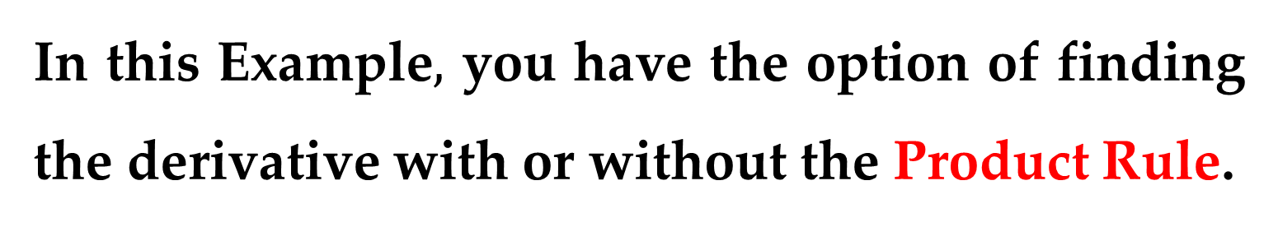
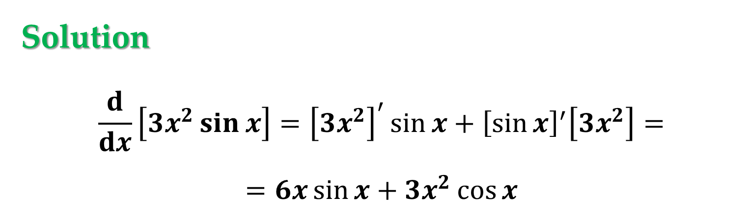

In this Example$,$ you have the option of finding the derivative with or without the Product Rule.
Example 2. Using the Product Rule
Find the derivative of $y\left(x\right)=3x^{2}\sin{x}$.
Solution
$$\frac{d}{dx}\left[3x^{2}\sin{x}\right]={\left[3x^{2}\right]}^{′}\sin{x}+{\left[\sin{x}\right]}^{′}\left[3x^{2}\right]=$$
$$=6x\sin{x}+3x^{2}\cos{x}$$

Slide 7

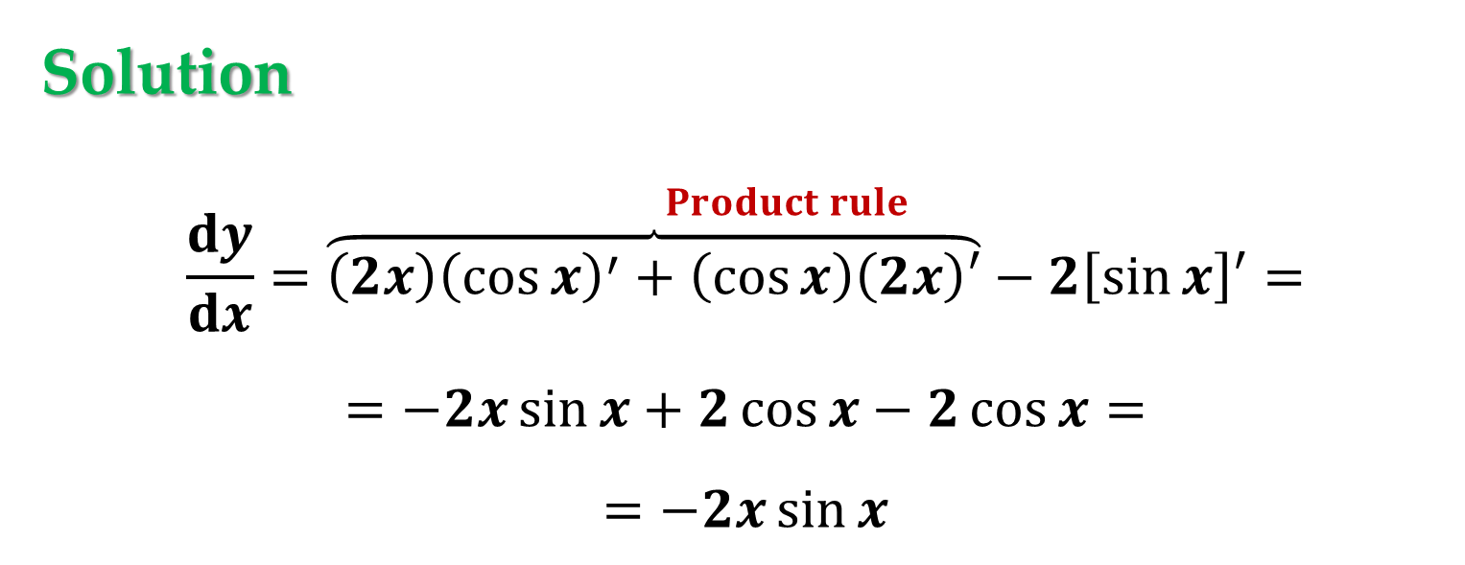
Example 3. Using the Product Rule
Find the derivative of
$$y\left(x\right)=2x\cos{x}−2\sin{x}$$
Solution
$$\frac{dy}{dx}=\overset{Product rule}{\overbrace{\left(2x\right){\left(\cos{x}\right)}^{′}+\left(\cos{x}\right)\left(2x\right)′}−2\left[\sin{x}\right]′}=$$
$$=−2x\sin{x}+2\cos{x}−2\cos{x}=$$
$$=−2x\sin{x}$$

Slide 8
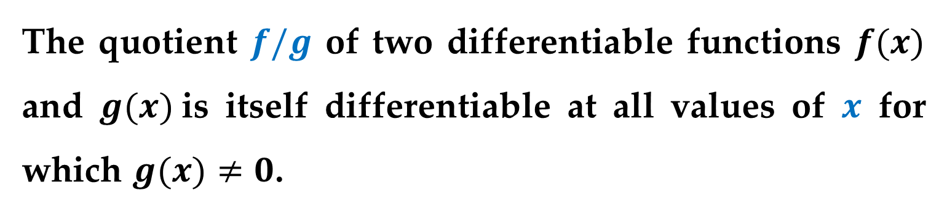
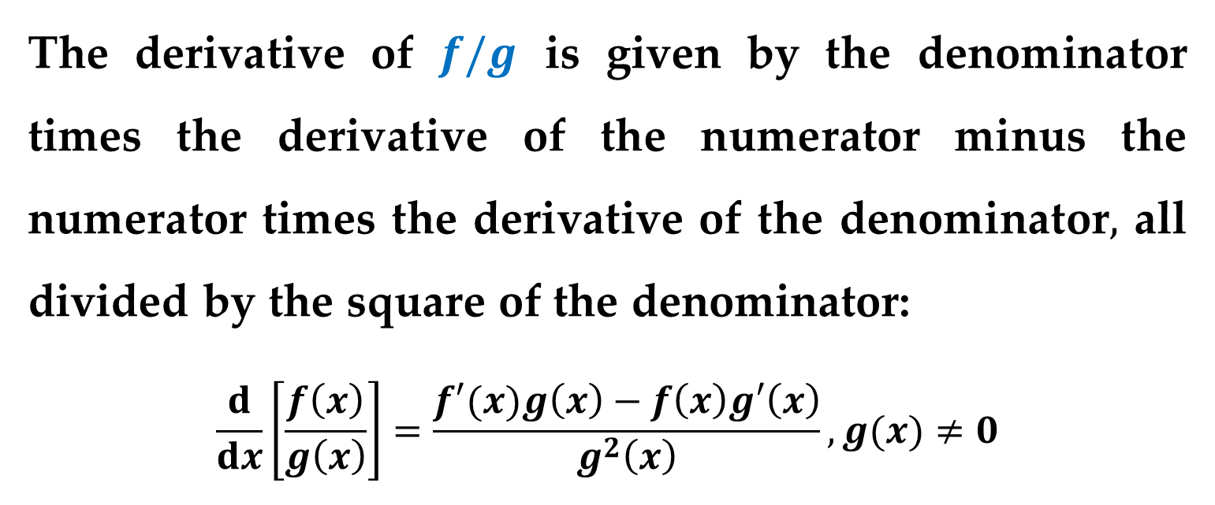
The Quotient Rule
The quotient $f/g$ of two differentiable functions $f(x)$ and $g(x)$is itself differentiable at all values of $x$ for which $g(x)≠0$.
The derivative of $f/g$ is given by the denominator times the derivative of the numerator minus the numerator times the derivative of the denominator$,$ all divided by the square of the denominator:
$$\frac{d}{dx}\left[\frac{f\left(x\right)}{g\left(x\right)}\right]=\frac{f′(x)g\left(x\right)−f\left(x\right)g′\left(x\right)}{g^{2}\left(x\right)}, g(x)≠0$$

Slide 9
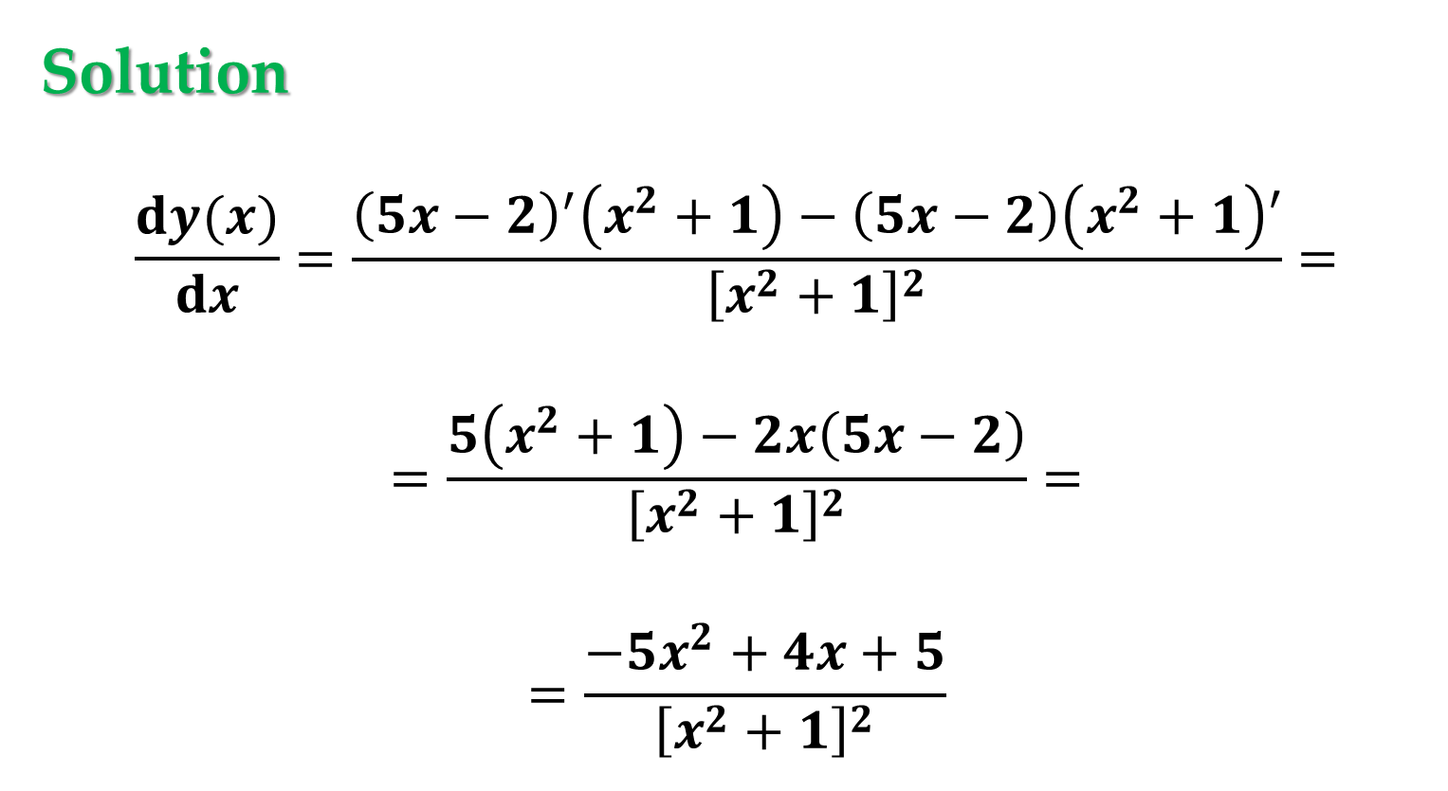
Example 4. Using the Quotient Rule
Find the derivative of $y\left(x\right)=\frac{5x−2}{x^{2}+1}$.
Solution
$$\frac{dy(x)}{dx}=\frac{{\left(5x−2\right)}^{′}\left(x^{2}+1\right)−\left(5x−2\right)\left(x^{2}+1\right)′}{{\left[x^{2}+1\right]}^{2}}=$$
$$=\frac{5\left(x^{2}+1\right)−2x\left(5x−2\right)}{{\left[x^{2}+1\right]}^{2}}=$$
$$=\frac{−5x^{2}+4x+5}{{\left[x^{2}+1\right]}^{2}}$$

Slide 10

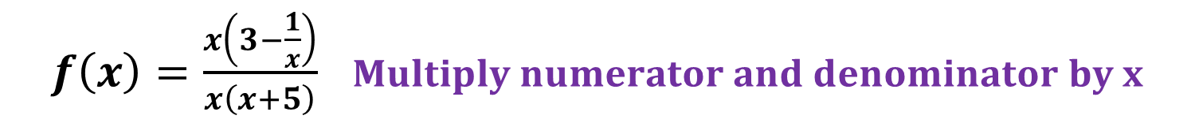
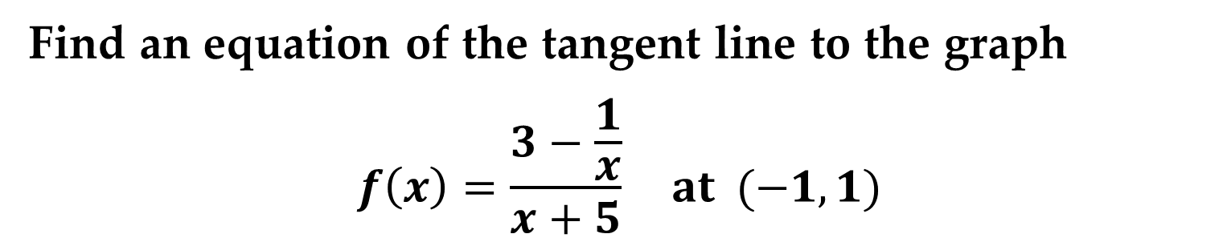
Example 5. Rewriting Before Differentiating
Find an equation of the tangent line to the graph
$$f\left(x\right)=\frac{3−\frac{1}{x}}{x+5} at (−1,1)$$
Solution
Begin by rewriting the function:
$f\left(x\right)=\frac{3−\left(\frac{1}{x}\right)}{x+5}$ $Write original function$
$f\left(x\right)=\frac{x\left(3−\frac{1}{x}\right)}{x\left(x+5\right)}$ $Multiply numerator and denominator by x$
$f\left(x\right)=\frac{3x−1}{x^{2}+5x}$ $Rewrite$

Slide 11
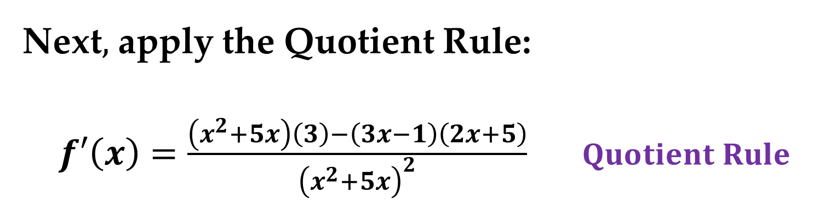


Solution (continued)
Next$,$ apply the Quotient Rule:
$f′\left(x\right)=\frac{\left(x^{2}+5x\right)\left(3\right)−\left(3x−1\right)\left(2x+5\right)}{{\left(x^{2}+5x\right)}^{2}}$ $Quotient Rule$
$f′\left(x\right)=\frac{\left(3x^{2}+15x\right)−\left(6x^{2}+13x−5\right)}{{\left(x^{2}+5x\right)}^{2}}$ $Simplify$
$f′\left(x\right)=\frac{−3x^{2}+2x+5}{{\left(x^{2}+5x\right)}^{2}}$ $Further simplify$

Slide 12
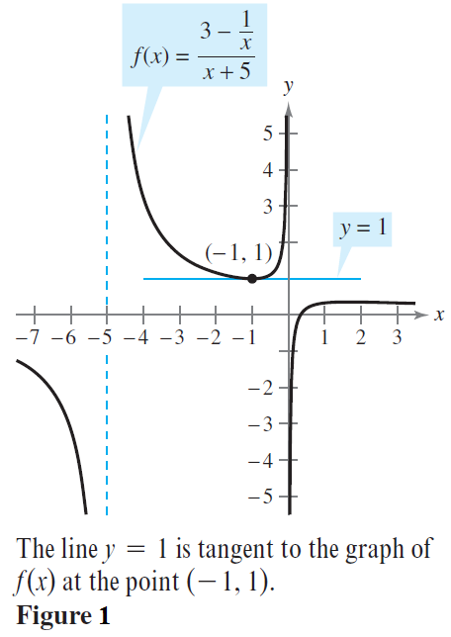
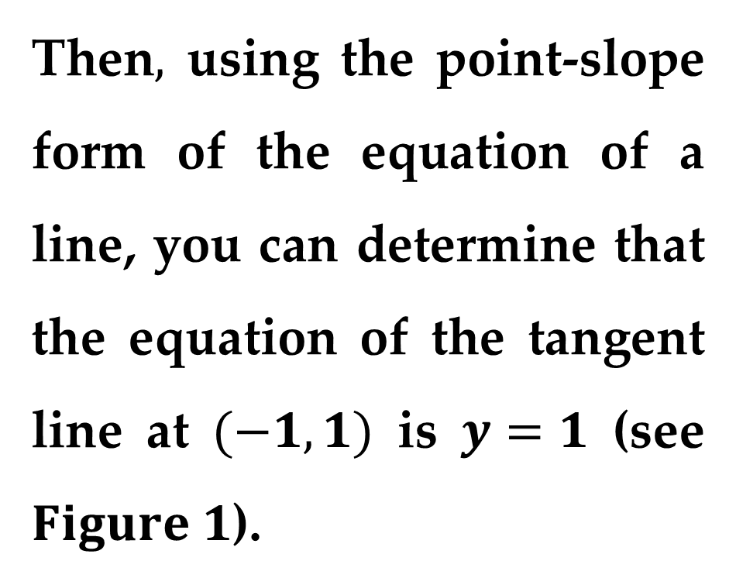
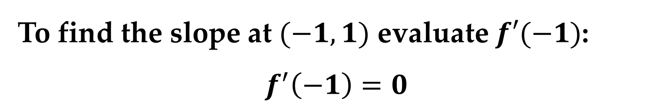
Solution (continued)
To find the slope at $(−1,1)$ evaluate $f′(−1)$:
$$f^{′}\left(−1\right)=0$$
Then$,$ using the point-slope form of the equation of a line, you can determine that the equation of the tangent line at $(−1,1)$ is $y=1$ (see $Figure 1$).

Slide 13
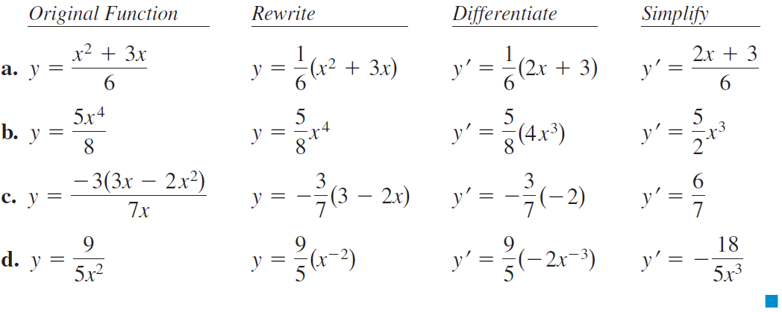
Example 6. Using the Constant Multiple Rule
Not every quotient needs to be differentiated by the Quotient Rule. Sometimes it is more convenient to use the Constant Multiple Rule.

Slide 14
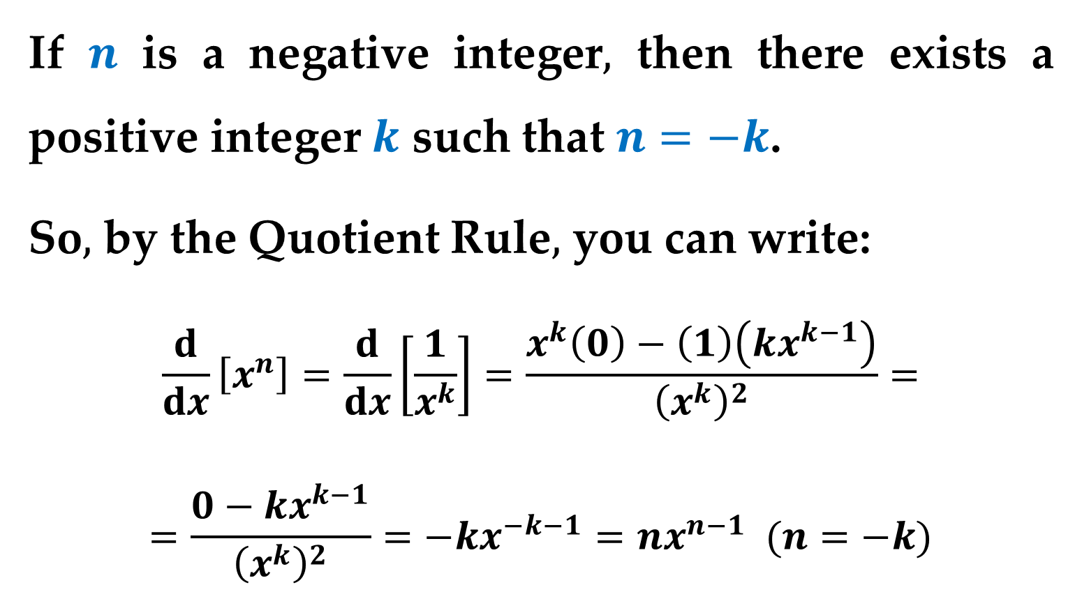
Example 7. Proof of the Power Rule
(The Case of Negative Integer Exponents)
If $n$ is a negative integer$,$ then there exists a positive integer $k$ such that $n=−k$.
So$,$ by the Quotient Rule$,$ you can write:
$$\frac{d}{dx}\left[x^{n}\right]=\frac{d}{dx}\left[\frac{1}{x^{k}}\right]=\frac{x^{k}\left(0\right)−\left(1\right)\left(kx^{k−1}\right)}{{\left(x^{k}\right)}^{2}}=$$
$$=\frac{0−kx^{k−1}}{{\left(x^{k}\right)}^{2}}=−kx^{−k−1}=nx^{n−1} (n=−k)$$

Slide 15
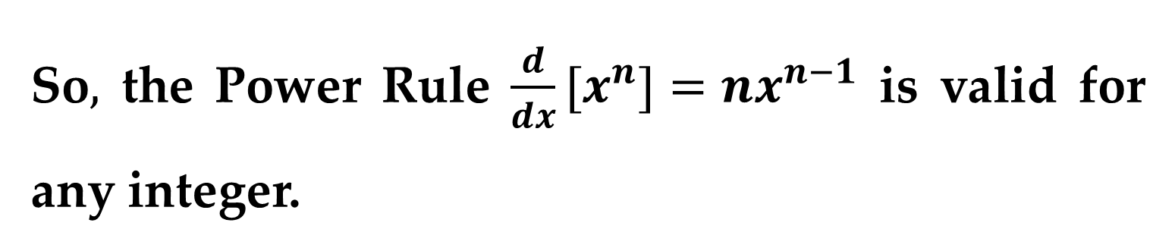
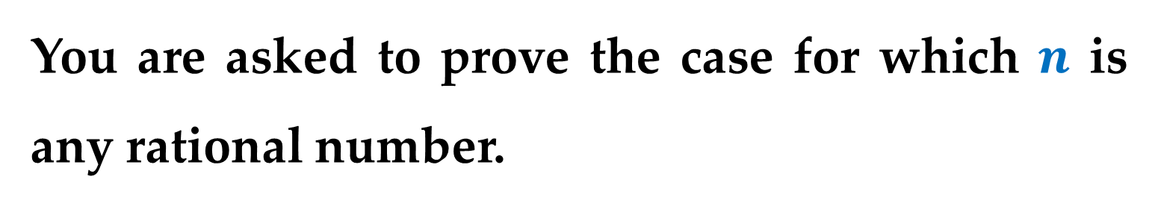
So$,$ the Power Rule $\frac{d}{dx}[x^{n}]=nx^{n−1}$ is valid for any integer.
Task
You are asked to prove the case for which $n$ is any rational number.

Slide 16
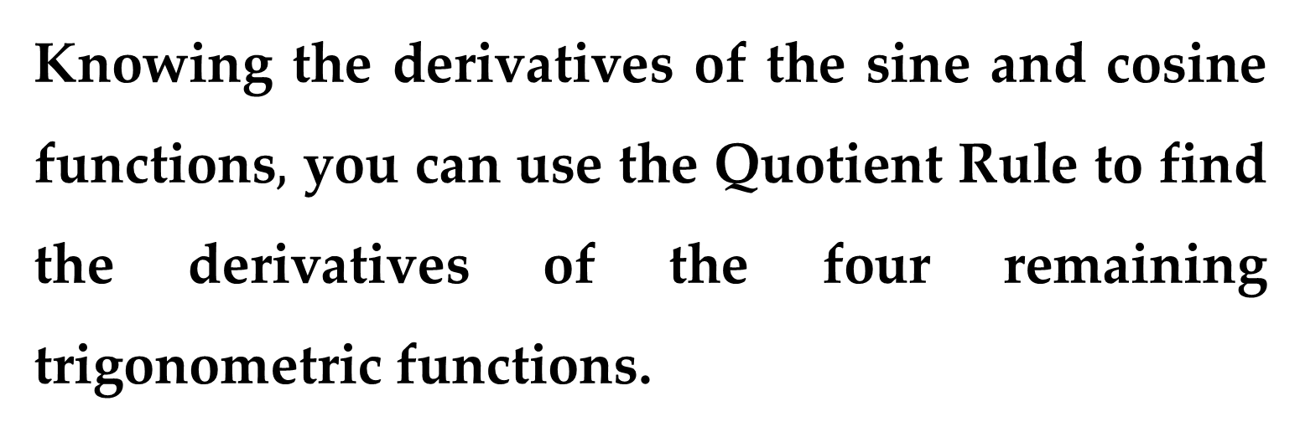
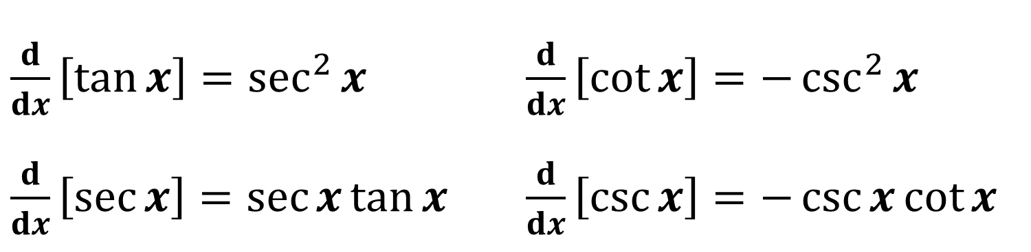
Derivatives of Trigonometric Functions
Knowing the derivatives of the sine and cosine functions$,$ you can use the Quotient Rule to find the derivatives of the four remaining trigonometric functions.
$\frac{d}{dx}\left[\tan{x}\right]=\sec^{2}{x}$ $\frac{d}{dx}\left[\cot{x}\right]=−\csc^{2}{x}$
$\frac{d}{dx}\left[\sec{x}\right]=\sec{x}\tan{x}$ $\frac{d}{dx}\left[\csc{x}\right]=−\csc{x}\cot{x}$

Slide 17
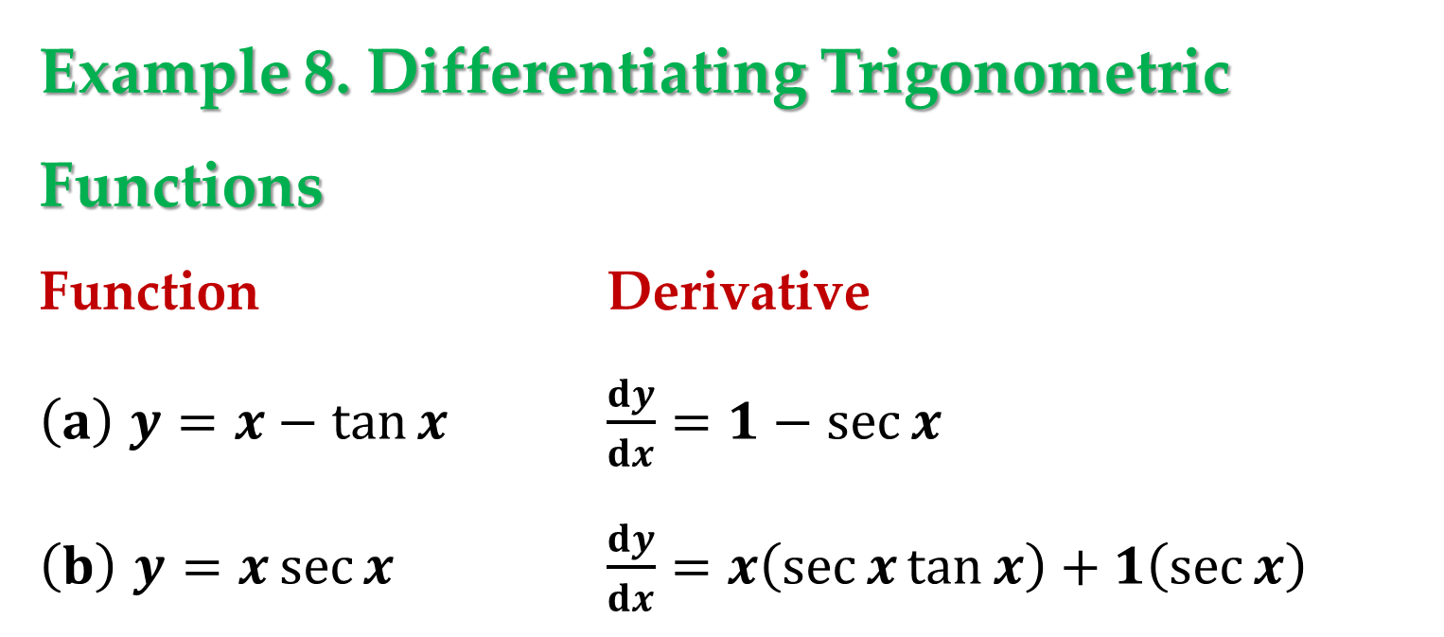
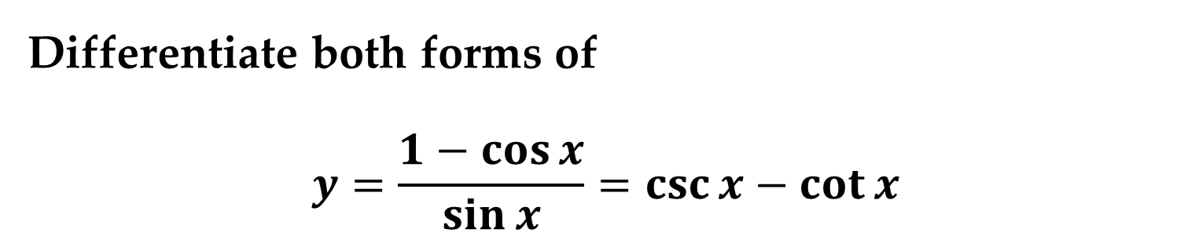
Example 8. Differentiating Trigonometric Functions
Function Derivative
$\left(a\right)$ $y=x−\tan{x}$ $\frac{dy}{dx}=1−\sec{x}$
$\left(b\right)$ $y=x\sec{x}$ $\frac{dy}{dx}=x\left(\sec{x}\tan{x}\right)+1\left(\sec{x}\right)$
Example 9. Different Forms of a Derivative
Differentiate both forms of
$$y=\frac{1−\cos{x}}{\sin{x}}=\csc{x}−\cot{x}$$

Slide 18
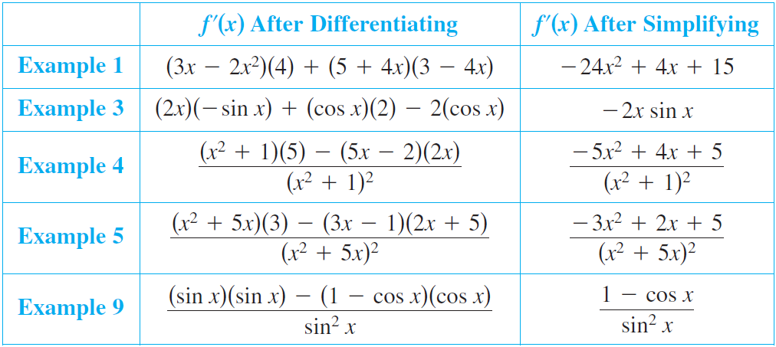
The summary below shows that much of the work in obtaining a simplified form of a derivative occurs after differentiating.

Slide 19
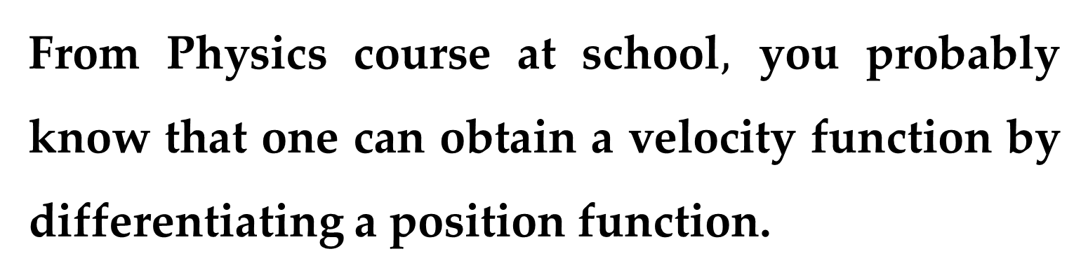
Higher-Order Derivatives
From Physics course at school$,$ you probably know that one can obtain a velocity function by differentiating a position function.
You might as well obtain an acceleration function by differentiating a velocity function.
Another way of looking at this is that you can obtain an acceleration function by differentiating a position function twice.

Slide 20
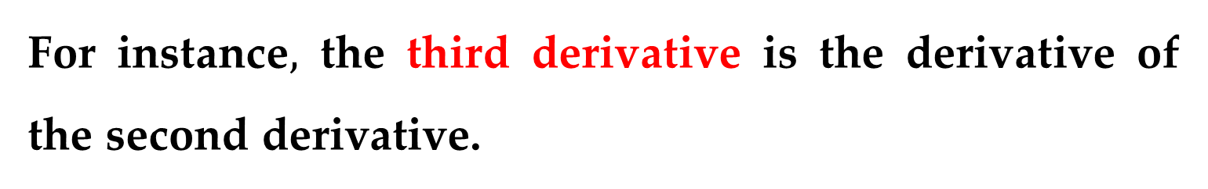
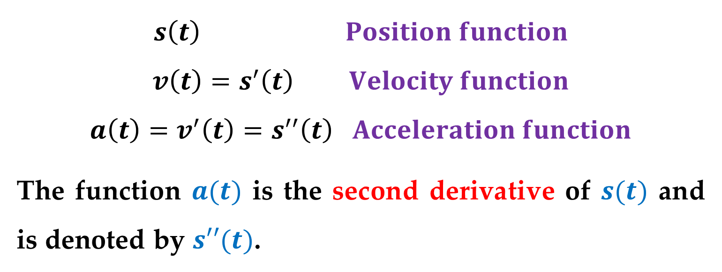
$$s\left(t\right) Position function$$
$$v\left(t\right)=s^{′}\left(t\right) Velocity function$$
$$a\left(t\right)=v^{′}\left(t\right)=s^{′′}\left(t\right) Acceleration function$$
The function $a(t)$ is the second derivative of $s(t)$ and is denoted by $s′′(t)$.
The second derivative is an example of a higher-order derivative. You can define derivatives of any positive integer order.
For instance$,$ the third derivative is the derivative of the second derivative.

Slide 21
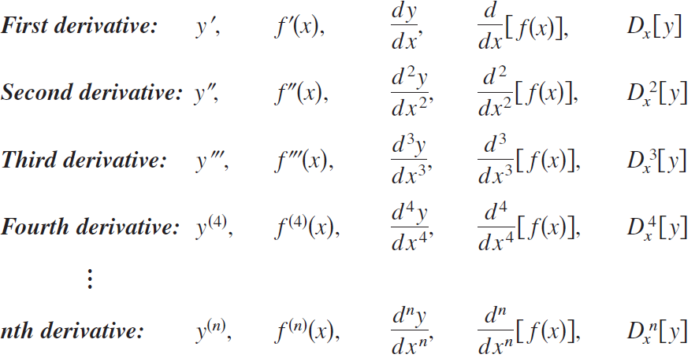
Higher-order derivatives are denoted as shown below:

Slide 22
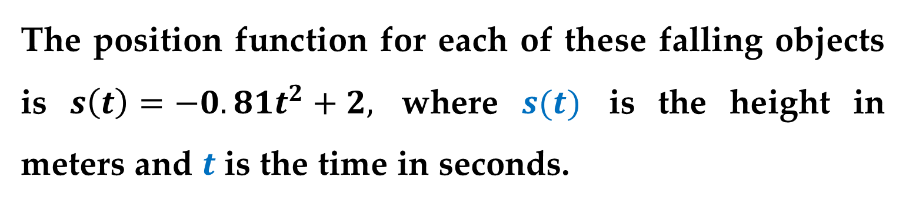
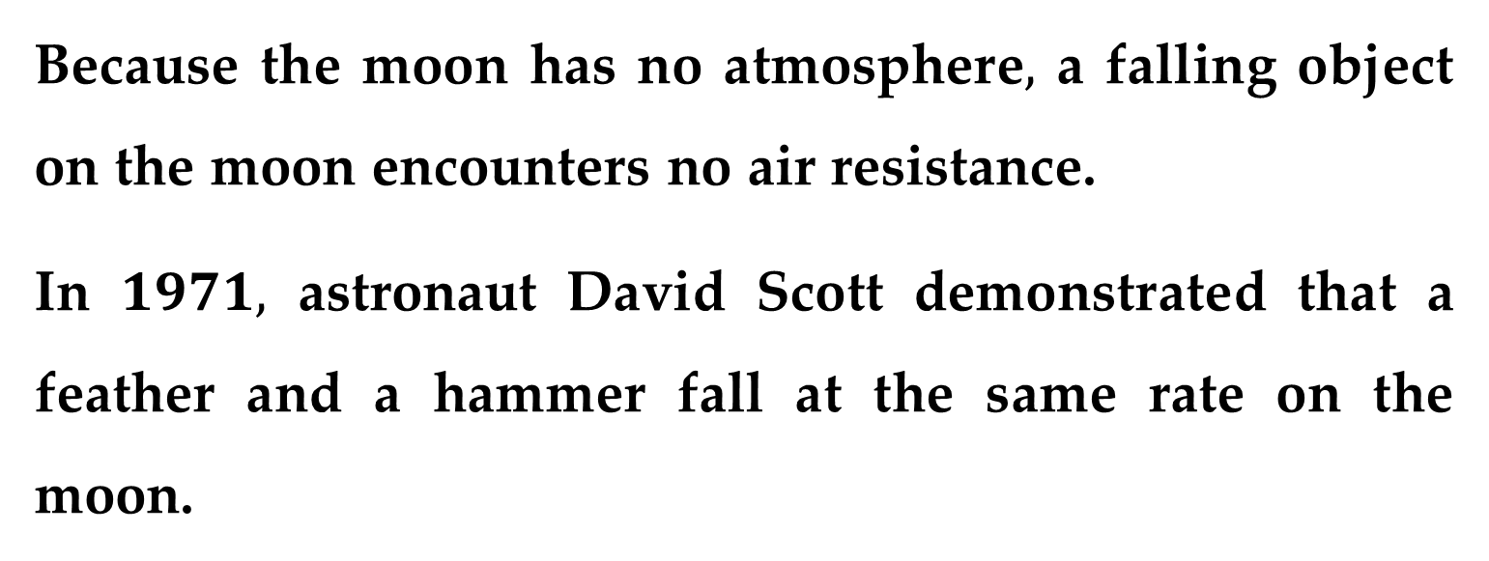
Example 10. Finding the Acceleration Due to Gravity
Because the moon has no atmosphere$,$ a falling object on the moon encounters no air resistance.
In $1971,$ astronaut David Scott demonstrated that a feather and a hammer fall at the same rate on the moon.
The position function for each of these falling objects is $s\left(t\right)=−0.81t^{2}+2,$ where $s(t)$ is the height in meters and $t$ is the time in seconds.

Slide 23
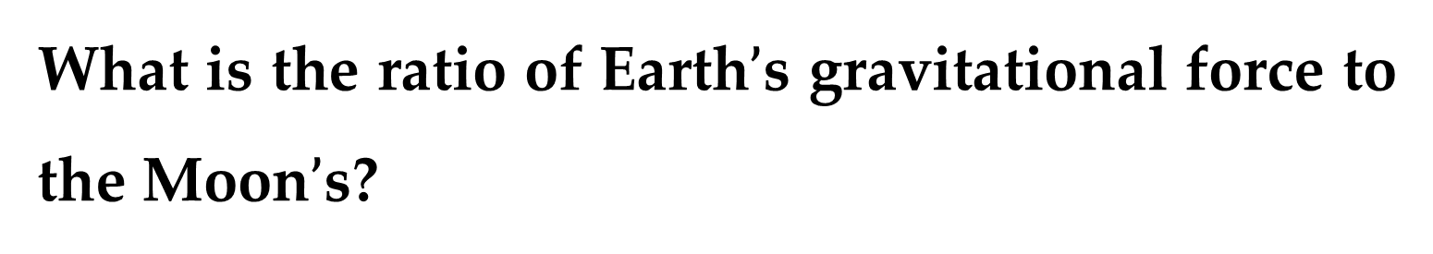
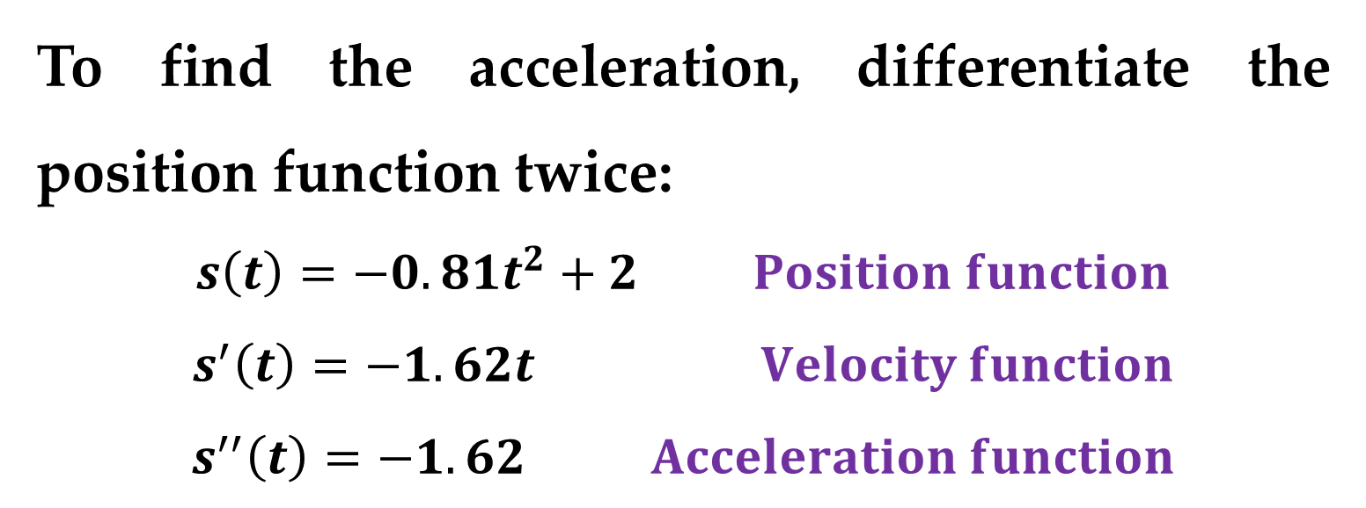
Example 10. (continued)
What is the ratio of Earth$’$s gravitational force to the Moon$’$s?
Solution
To find the acceleration, differentiate the position function twice:
$$s\left(t\right)=−0.81t^{2}+2 Position function$$
$$s^{′}\left(t\right)=−1.62t Velocity function$$
$$s^{′′}\left(t\right)=−1.62 Acceleration function$$

Slide 24
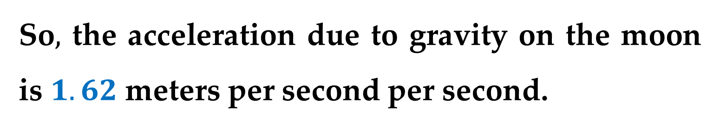
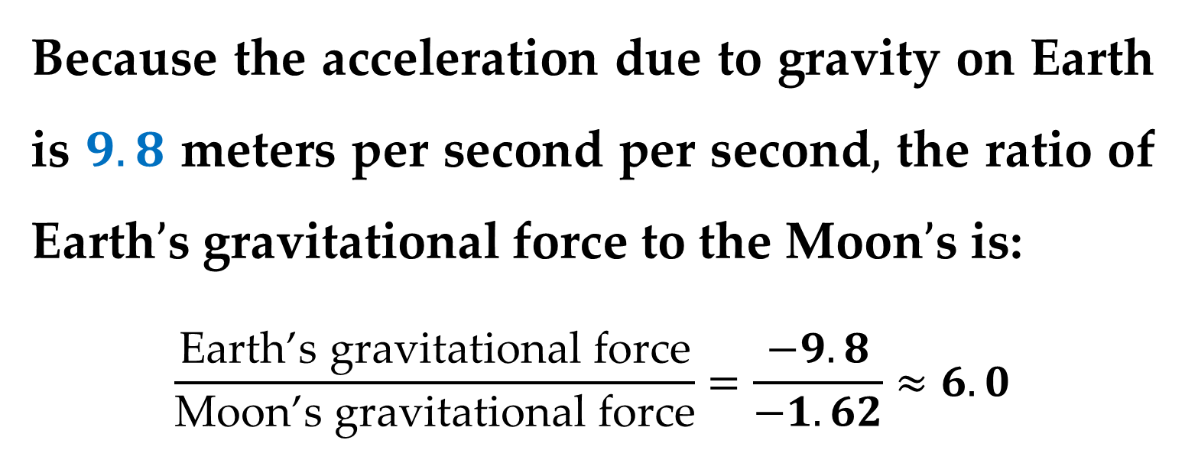
Solution
So$,$ the acceleration due to gravity on the moon is $1.62$ meters per second per second.
Because the acceleration due to gravity on Earth is $9.8$ meters per second per second$,$ the ratio of Earth$’$s gravitational force to the Moon$’$s is:
$$\frac{\text{Earth}\text{’}\text{s} \text{gravitational} \text{force}}{\text{Moon}\text{’}\text{s} \text{gravitational} \text{force}}=\frac{−9.8}{−1.62}≈6.0$$

Slide 25
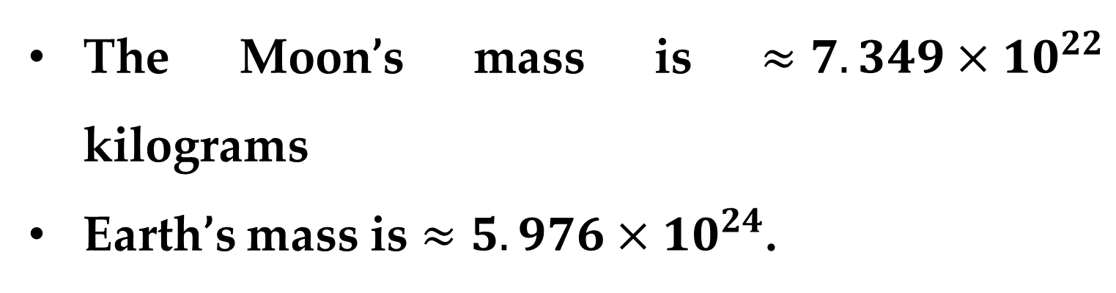
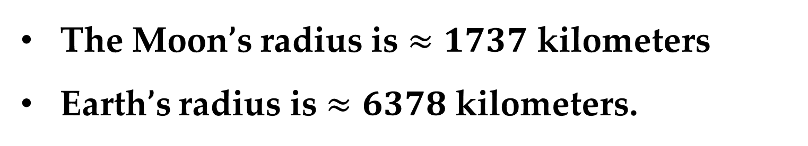
Solution (continued)
The Moon’s mass is $≈7.349×{10}^{22}$ kilograms
Earth’s mass is $≈5.976×{10}^{24}$.
The Moon’s radius is $≈1737$ kilometers
Earth’s radius is $≈6378$ kilometers.

Slide 26
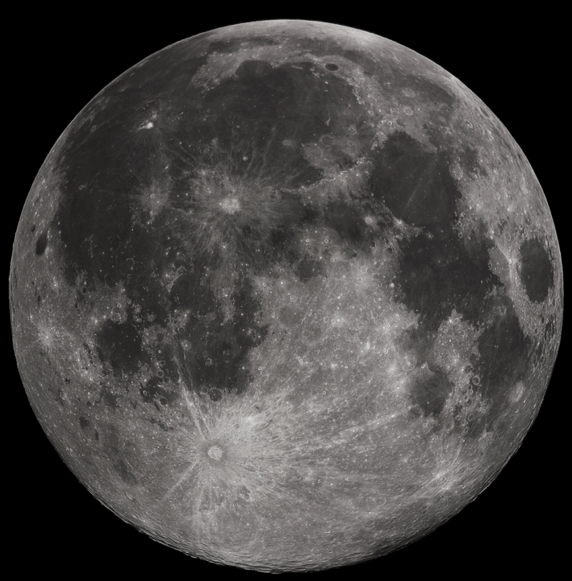
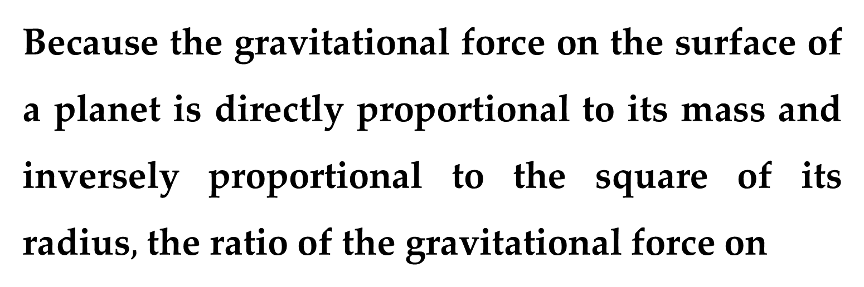
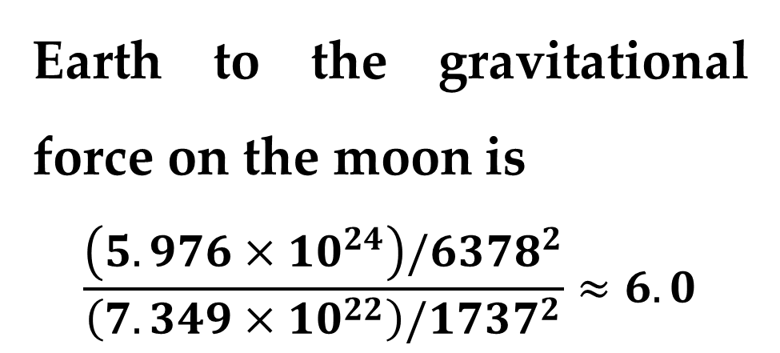
Solution (continued)
Because the gravitational force on the surface of a planet is directly proportional to its mass and inversely proportional to the square of its radius$,$ the ratio of the gravitational force on
Earth to the gravitational force on the moon is
$$\frac{\left(5.976×10^{24}\right)/6378^{2}}{\left(7.349×10^{22}\right)/1737^{2}}≈6.0$$

Slide 27
Thank you for attention

